Slide 1
Solution
Design for Compute

Slide 2













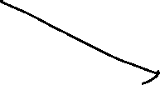

IaaS Architecture
Front-End
Middle-Tier/
Business Logic
Database
Internet

Slide 3




PaaS Architecture
Front-End
Middle-Tier/
Business Logic
Database
Internet

Slide 4




IaaS Architecture
Front-End
Middle-Tier/
Business Logic
Database
Internet
Front-End
Middle-Tier/
Business Logic
Database

Slide 5




PaaS Architecture
Front-End
Middle-Tier/
Business Logic
Database
Internet
Front-End
Middle-Tier/
Business Logic
Database

